Slide 1
Scope Of Problem

Slide 2
The COVID19 pandemic has forced students to stay at home.....
This has created a number of challenges
Students have difficulties finding and forming a team for their personal projects or group-based school assignments
Students are unable to seamlessly clarify their doubts and seek help from their peers or teachers

Slide 3
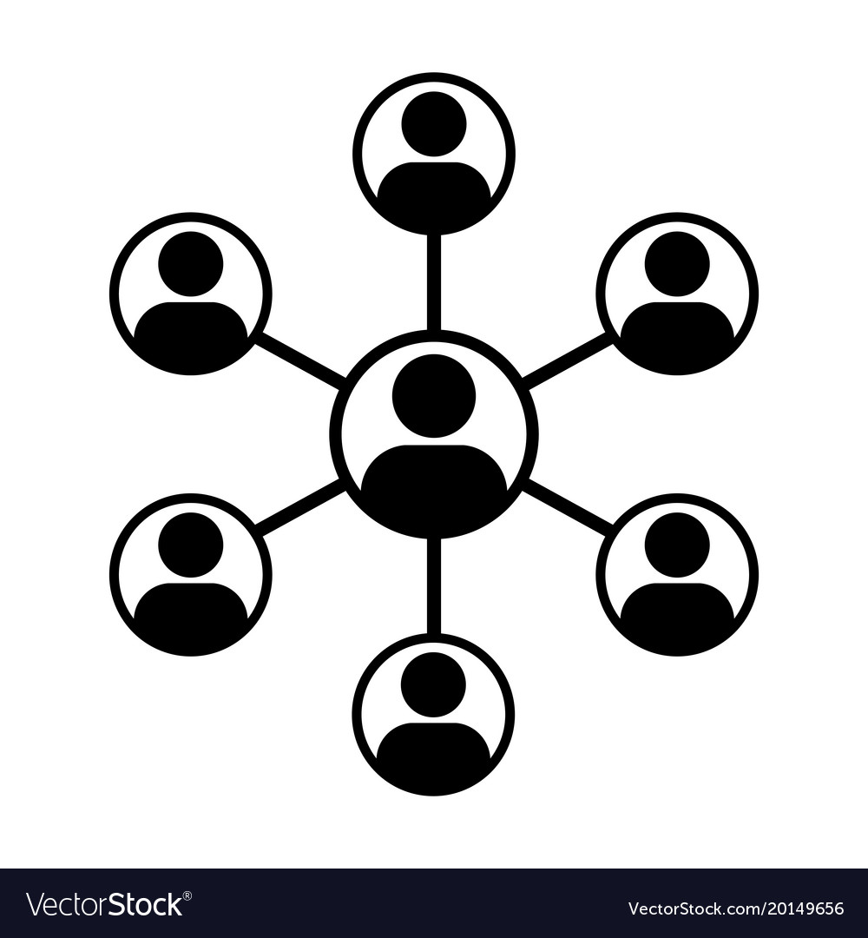

However, with innovative product design and engineering…...
We have created an app called “Collab” which will be the Linkedin for students enrolled in educational institutions.
Collab
allows you to
Find and network with your community digitally to collaborate on a project or seek assistance on school work

Slide 4
Proposed Solution / Use Case

Slide 5


Scenario 01
Alan wants to create a breakdancing app as he is passionate about breakdancing
However…. He has difficulties finding potential collaborators for this project such as app developers who also love breakdancing
Now with Collab…
Create a collaboration
project request on Collab
Displays the request to Collab users
Interested parties can accept and collaborate
Selective Filtering
Algorithm in Collab
who have breakdancing & app development profiles

Slide 6
Scenario 02
Jane is struggling on her CS tutorial questions and and wants to seek help from someone
However…. She has difficulties finding someone to explain the solution and concept to her in an understandable manner.
Now with Collab…
Create a collaboration
project request on Collab
Displays the request to Collab users
Interested parties can accept and collaborate
Selective Filtering
Algorithm in Collab
who have breakdancing & app development profiles

Slide 7
Technical Details

Slide 8
Technical Details
Backend: realtime and firestore database
Frontend App: flutter, google fonts 1.1.0,
Notes:
Need an introduction over here

Slide 9
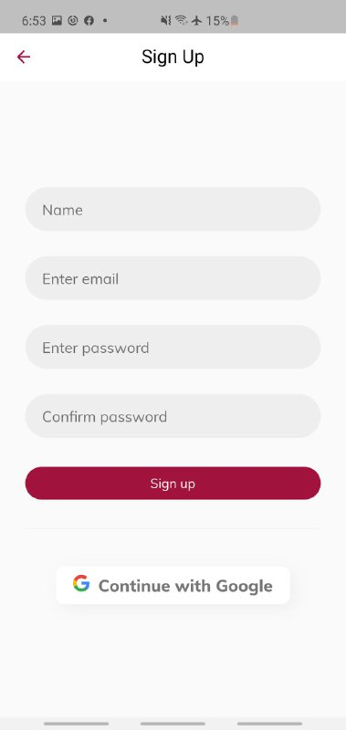
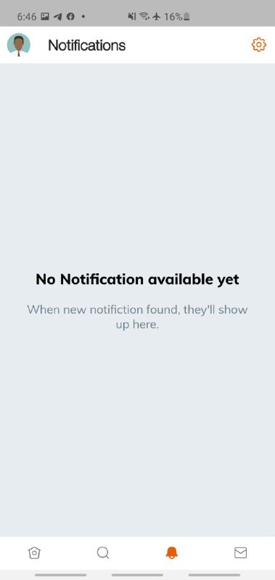
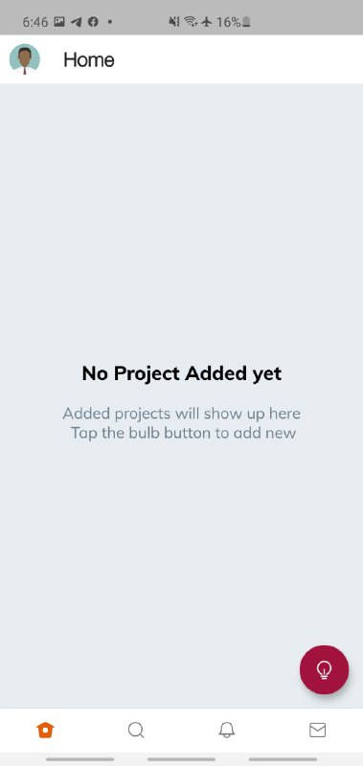
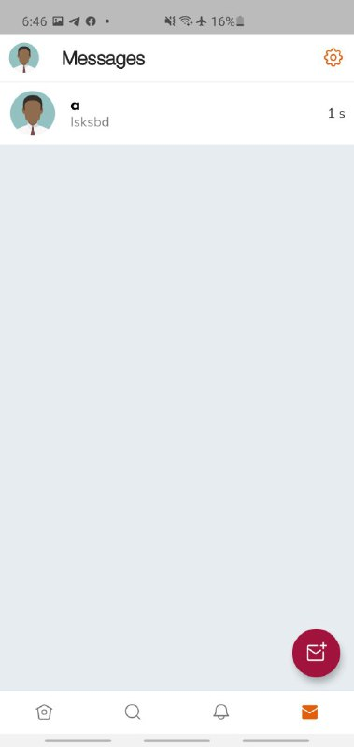
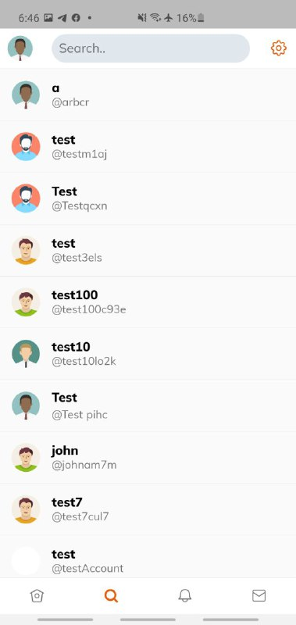
App Screenshots
User Login Page
Collaborator Notification Request
Project Listings
Messenger Feature

Slide 10
Usage Flow

Slide 11
Step 1
Account Creation
User creates a Collab profile account stating their interests, skills, major, education background and location. Those information are stored in searchable ‘Tags’ to facilitate finding collaborators and getting discovered.
Account Creation
Step 2
Step 3a
Step 3b
Step 4

Slide 12
Step 2
Creating a new collaboration project
Project owner creates a collaboration project request, stating the type of project, project description and details for other users to view
Project owner would create Roles for the project and include description and questions for potential collaborator for each Role and tagging each Role with relevant Tags.
Account Creation
Create new Project
Step 3a
Step 3b
Step 4

Slide 13
Step 3a
Finding people to invite
Project owners are able to search for individuals with the relevant skill and interest using tags specified in the Roles and send an invitation for them to fill the selected Roles.
Account Creation
Create new Project
Invite People
Step 3b
Step 4

Slide 14
Step 3b
Joining an existing project
Collaborators can join a project by accepting an invitation or sending an application for a Role. Collaborators can also self-source for existing project using general tags like interest, school, distance and background or specific tags like NUS, Year2 CS
Account Creation
Create new Project
Invite People
Join projects
Step 4

Slide 15
Step 4
Establishing a group chat for the project team
Collaborators will be added to a project group chat for ease of communication upon mutual acceptance of collaboration request
Account Creation
Create new Project
Invite People
Join
projects
Establish Project Team

Slide 16
Discover Feed
Tailored Project Discovery page that recommends open projects using Machine Learning Algorithms based on the information from your tags and your profile
Account Creation
Create new Project
Invite People
Join
projects
Establish Project Team

Slide 17
The platform is not just limited to students. It can be extended to include musicians, writers, dancers or even artist and can be used to connect talents needed for any project.
Account Creation
Create new project
Invite People
Join a Project
Establish project team
Eventually… the goal for Collab
is to be an Open Platform for Collaboration for everyone
Notes:
Done by Team 505 (Joel,Jiade,Jinwei,Anthony)

